Slide 1
Design Variation + Performance Map Using SimericsMP
Python Script Solution

Slide 2
Objectives + Prerequisites
Objectives:
Instantly create multiple CFturbo designs with varying design parameters for study of optimization and sensitivity (slide #3)
Streamline the workflow that is running multiple simulations using SimericsMP to construct a performance map (slide #19)
Prerequisites:
Cfturbo
https://cfturbo.com/software/download
SimericsMP
Python (3.10.1)
https://www.python.org/downloads/
Text Editor (Visual Studio Code)
https://code.visualstudio.com/download
Python Extension
Microsoft Excel
CFturbo Inc. Python Scripts
https://github.com/sandschristopher/master

Slide 3
Design Variation + Performance Map Using SMP (A + B)
General Workflow:
Run steady-state simulations for each design variation
Analyze performance of each design variable to find optimal design
Run a full performance map for the optimal design
General Outline – Design Variation:
Create and Prepare Project Folder
Select Design Variation Parameters/Export to SimericsMP
User Modification of master.cftconf
Run master.py within Visual Studio Code
Fill in Design Parameter Values in .csv
Open Results .csv File for Post-Processing

Slide 4
Design Variation + Performance Map Using SMP (A + B)
General Workflow:
Run steady-state simulations for each design variation
Analyze performance of each design variable to find optimal design
Run a full performance map for the optimal design
General Outline – Design Variation:
Create and Prepare Project Folder
Select Design Variation Parameters/Export to SimericsMP
User Modification of master.cftconf
Run master.py within Visual Studio Code
Fill in Design Parameter Values in .csv
Open Results .csv File for Post-Processing

Slide 5
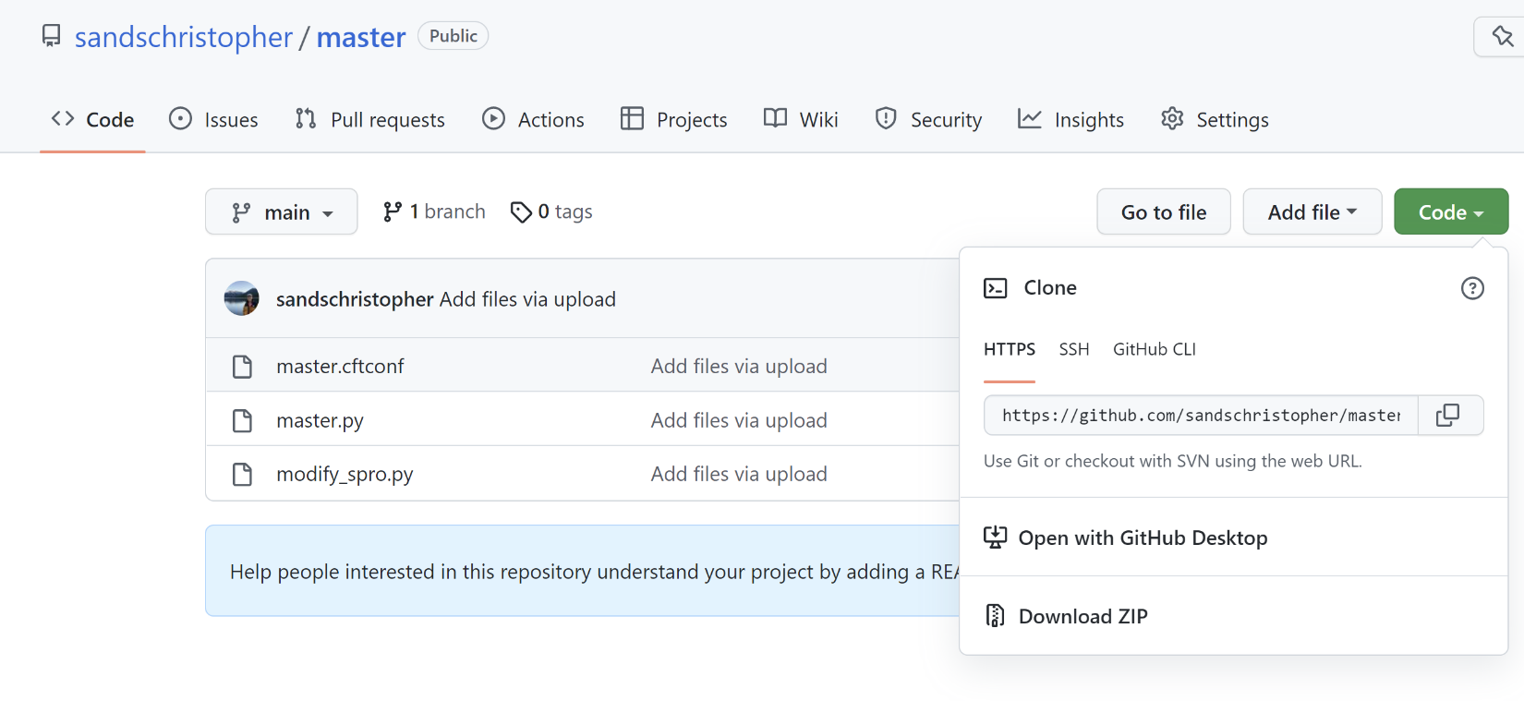
I. Create and Prepare Project Folder
Create and name a project folder accordingly (e.g. axial-fan_v1)
Download the CFturbo python scripts from github repository and place within project folder:
master.cftconf
master.py
modify_spro.py
Ensure the Cfturbo Design File (project_name.cft) is also in the project folder, both with the same name!

Slide 6
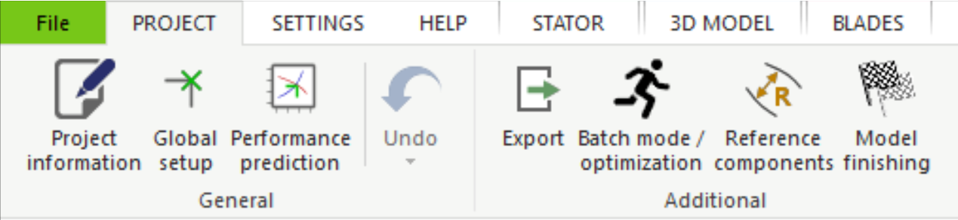
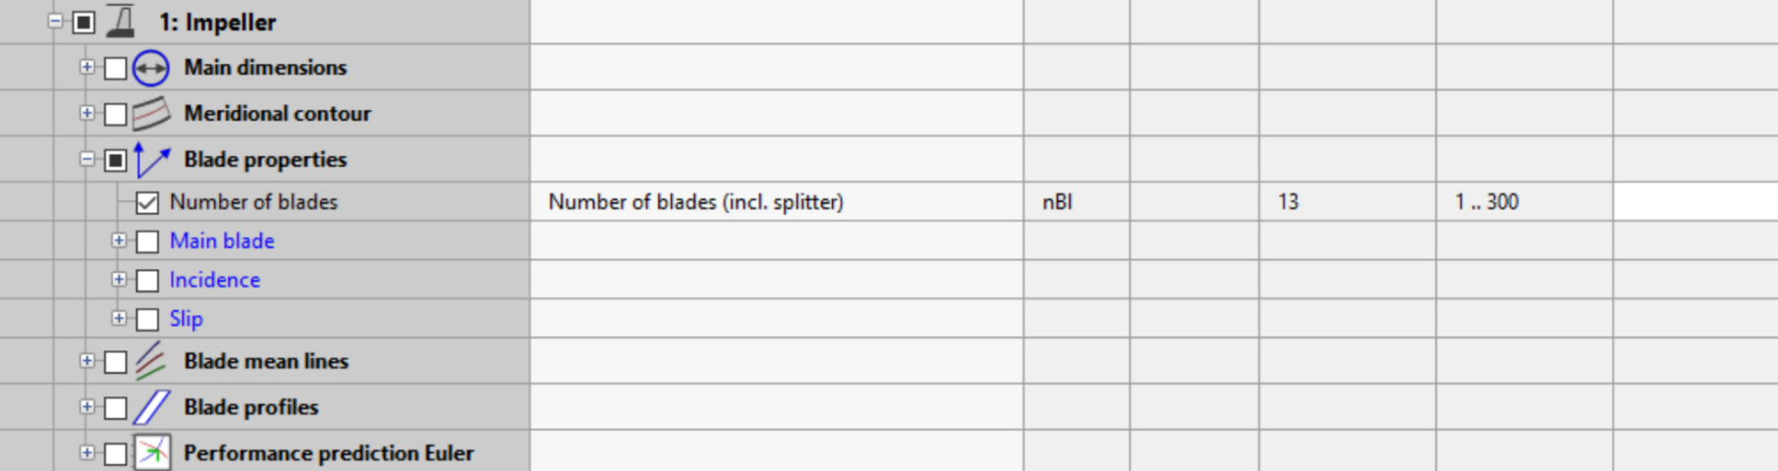
II. Select Design Variation Parameters/Export to SMP
After the design process within CFturbo, select Batch mode/optimization under the Project tab
Under the Parameters tab, check the box corresponding to each design parameter you wish to vary.

Slide 7
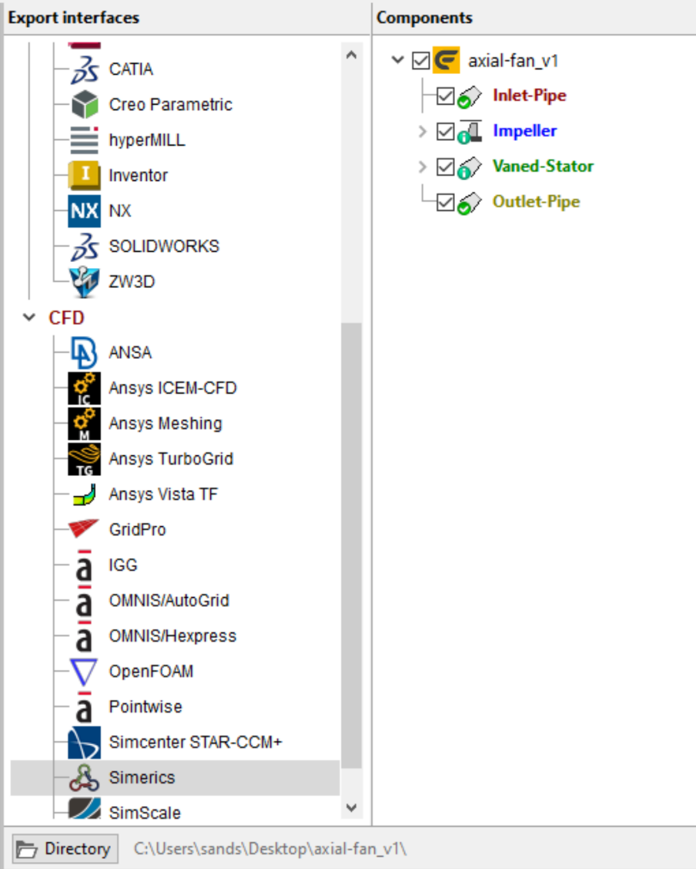
II. Select Design Variation Parameters/Export to SMP (cont.)
Under the Export actions tab:
Within the Export interfaces window, open CFD and highlight Simerics
Within the Components window, check the box corresponding to the design component you wish to include in the simulation geometry
Select Directory and assign the project folder

Slide 8

II. Select Design Variation Parameters/Export to SMP (cont.)
Within the Settings window, ensure Export all files is selected in the dropdown menu
Select Solver and choose the Steady solver type from the dropdown menu
Denote the base file name with the marker that suggests the steady solver type (_steady)

Slide 9
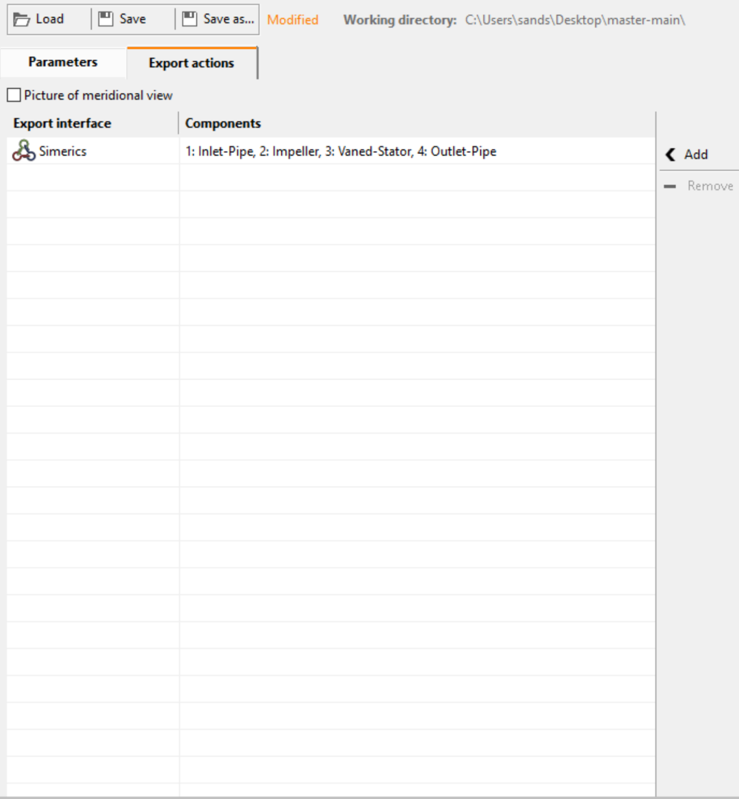
II. Select Design Variation Parameters/Export to SMP (cont.)
Click Add
Click Save as... and save the CFturbo Batch File to the project folder with the marker that suggests the steady solver type (e.g. axial-fan_v1_steady.cft-batch)

Slide 10
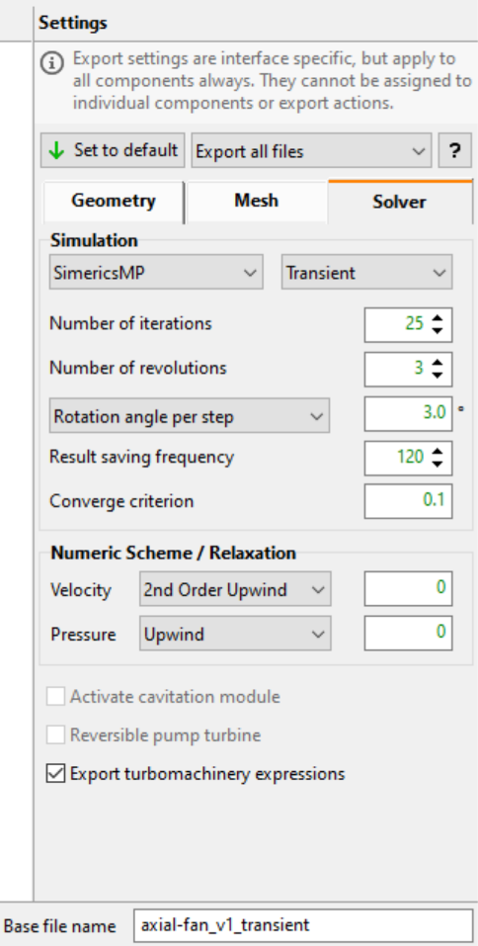
II. Select Design Variation Parameters/Export to SMP (cont.)
If transient simulation results are desired, then repeat:
Within the Settings window, ensure Export all files is selected in the dropdown menu
Select Solver and choose the Transient solver type from the dropdown menu
Denote the base file name with the marker that suggests the transient solver type (_transient)

Slide 11
II. Select Design Variation Parameters/Export to SMP (cont.)
Click Add
Click Save as... and save the CFturbo Batch File to the project folder with the marker that suggests the transient solver type (e.g. axial-fan_v1_transient.cft-batch)

Slide 12
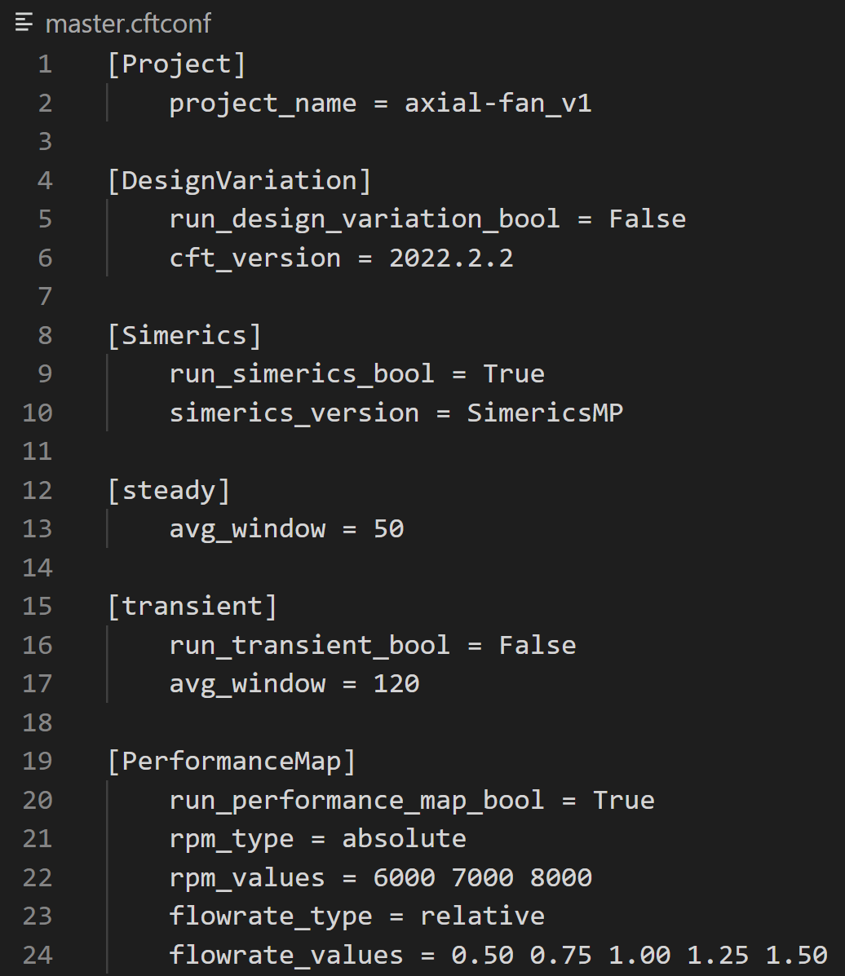
III. User Modification of master.cftconf
Open the project folder within the text editor and select the master.cftconf file

Slide 13
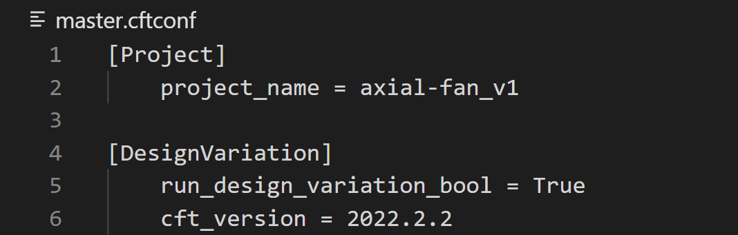
III. User Modification of master.cftconf (Cont.)
Under [Project]:
Assign the project name to project_name
This should be consistent with the base file name and project folder named previously
Under [DesignVariation]:
Set run_design_variation_bool to True
Set cft_version to the CFturbo version being used (e.g. 2022.2.2)

Slide 14
III. User Modification of master.cftconf (Cont.)
Under [Simerics]:
Set run_simerics_bool to True
Set simerics_version to either SimericsMP or SimericsMP+
Under [Steady]:
Set avg_window to an appropriate integer value for averaging of iterations
Under [Transient]:
Set run_transient_bool to True or False
Set avg_window to an appropriate integer value for averaging of timesteps

Slide 15
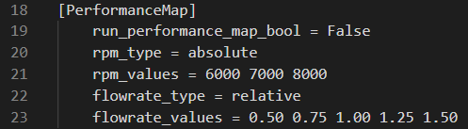
III. User Modification of master.cftconf (Cont.)
Under [PerformanceMap]:
Set run_performance_map_bool to False

Slide 16
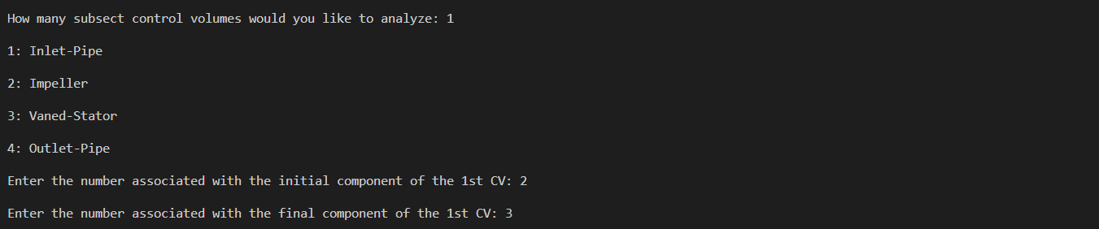
IV. Run master.py in VS Code
Within the text editor, open terminal and run the master.py
If using Visual Studio Code:
Select Terminal > New Terminal
Within the terminal type python master.py and click Enter on keyboard
Use the pip3 install [library] command to install the necessary libraries
The user is prompted to input information regarding subsecting control volumes within the flow path:
How many subsecting CVs they wish to examine
The number associated with the initial/final component of each subsecting CV

Slide 17
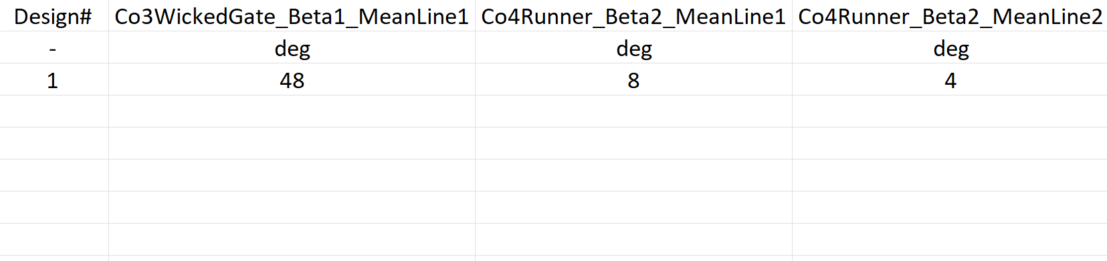
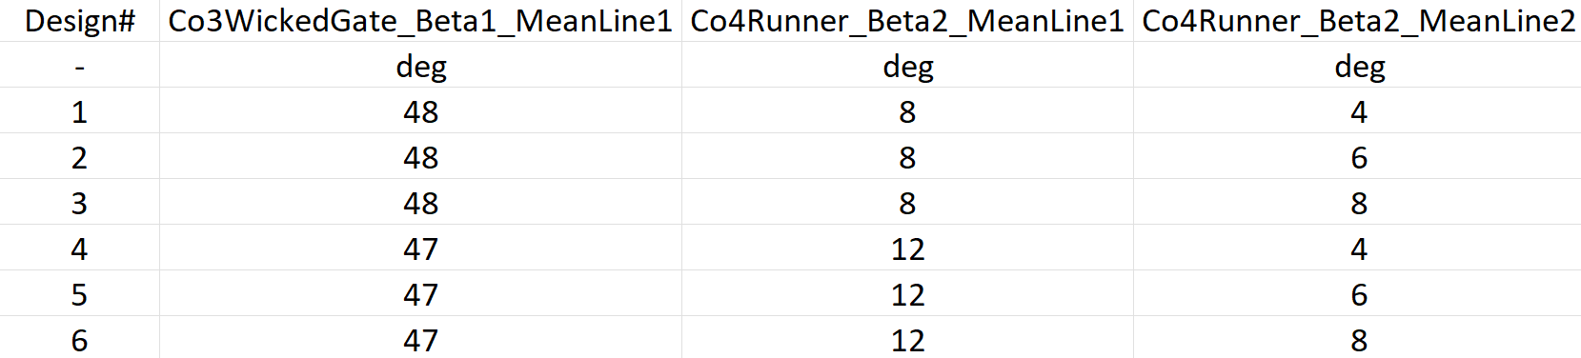
V. Fill in Design Parameter Values in .csv
Once python master.py is executed, the user will be prompted to fill a resultant .csv file with respective values
Once done filling the .csv file with design parameter values, return to the Terminal and press <Enter>

Slide 18
VI. Open Results .csv File for Post-Processing
Manual convergence control can be analyzed simultaneously within the SimericsMP application
Wait for the program to finish
Within File Explorer, open the resultant .csv files
The averaged results of performance characteristics for each Cfturbo design are displayed
The user should examine the performance of each design and run the following performance map script for the optimal design

Slide 19
Performance Map Using SMP (B Only)
General Outline - Performance Map:
Create and Prepare Project Folder
CFturbo Design Export to SimericsMP
User Modification of master.cftconf
Run master.py within Visual Studio Code
Open Results .csv File for Post-Processing

Slide 20
I. Create and Prepare Project Folder
Create and name a project folder accordingly
Download the CFturbo python scripts from github repository and place within project folder:
master.cftconf
master.py
modify_spro.py

Slide 21
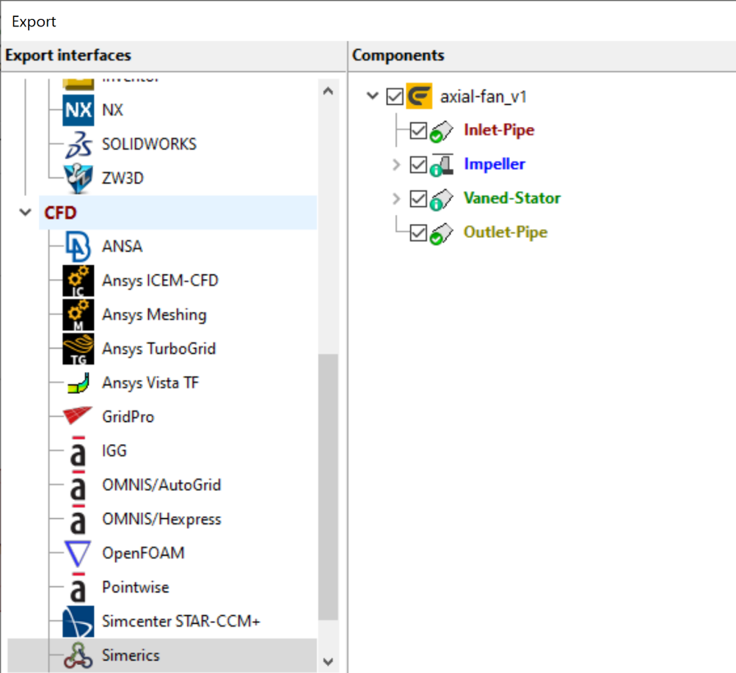
II. CFturbo Design Export to SimericsMP
Open the optimal design Cfturbo Design file, select Export
Under Export interfaces open CFD and select Simerics
Under Components check the design parts to include in the simulations geometry

Slide 22
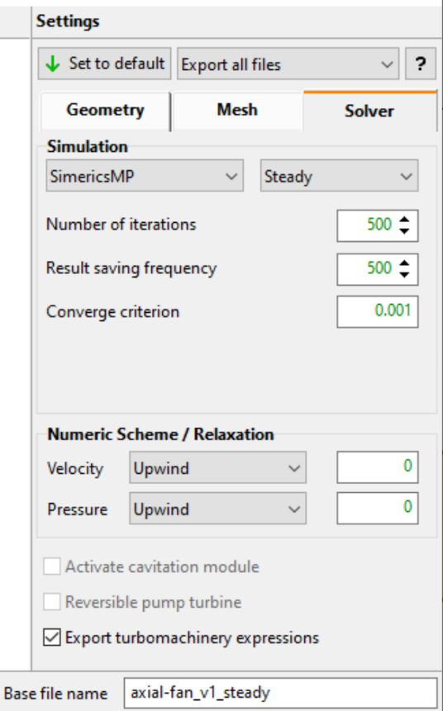
II. CFturbo Design Export to SimericsMP (Cont.)
Under Settings, ensure Export all files is selected in the dropdown menu
Select Solver and choose the Steady solver type from the dropdown menu
steady simulations are necessary to run transient simulations
Denote the base file name with the marker that suggests the steady solver type (_steady)

Slide 23

II. CFturbo Design Export to SimericsMP (Cont.)
Assign the project folder to the Directory
Select Export
Note: If Transient simulation results are desired, Steady simulations should be run

Slide 24
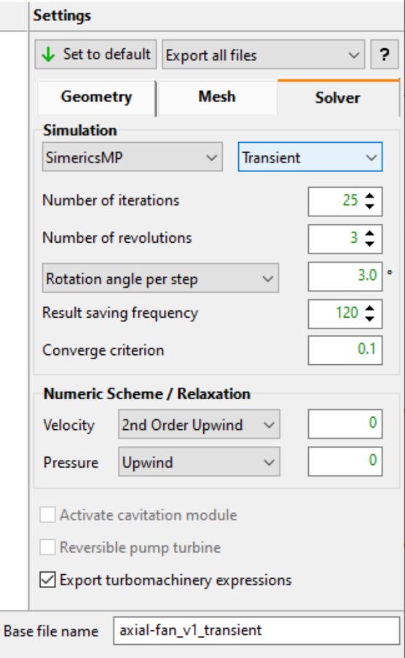
II. CFturbo Design Export to SimericsMP (Cont.)
If transient simulation results are desired, then repeat:
Under Settings, ensure Export all files is selected in the dropdown menu
Select Solver and choose the Transient solver type from the dropdown menu
steady simulations are necessary to run transient simulations
Denote the base file name with the marker that suggests the transient solver type (_transient)

Slide 25

II. CFturbo Design Export to SimericsMP (Cont.)
Assign the project folder to the Directory
Select Export
Note: If Transient simulation results are desired, Steady simulations should be run

Slide 26
III. User Modification of master.cftconf
Open the project folder within the text editor and select the master.cftconf file

Slide 27
III. User Modification of master.cftconf (Cont.)
Under [Project]:
Assign the project name to project_name
This should be consistent with the base file name and project folder named previously, or be the file name of the optimal design determined from design variation
Under [DesignVariation]:
Set run_design_variation_bool to False
Set cft_version to the CFturbo version being used (e.g. 2022.2.2)

Slide 28
III. User Modification of master.cftconf (Cont.)
Under [Simerics]:
Set run_simerics_bool to True
Set simerics_version to either SimericsMP or SimericsMP+
Under [Steady]:
Set avg_window to an appropriate integer value for averaging of iterations
Under [Transient]:
Set run_transient_bool to True or False
Set avg_window to an appropriate integer value for averaging of timesteps

Slide 29
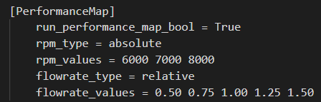
III. User Modification of master.cftconf (Cont.)
Under [PerformanceMap]:
Set run_performance_map_bool to True
Set rpm_type to relative or absolute
Assign the respective values to rpm_values
Set flowrate_type to relative or absolute
Assign the respective values to flowrate_values
Note: If using absolute values for flowrate_values, the values must be in cubic meters per second or kilograms per second; flowrates can be either volumetric or mass but must be consistent with that of the Design Point in the Global setup within CFturbo

Slide 30
IV. Run master.py in VS Code
Within the text editor, open terminal and run the master.py
If using Visual Studio Code:
Select Terminal > New Terminal
Within the terminal type python master.py and click Enter on keyboard
Use the pip3 install [library] command to install the necessary libraries
The user is prompted to input information regarding subsecting control volumes within the flow path:
How many subsecting CVs they wish to examine
The number associated with the initial/final component of each subsecting CV

Slide 31
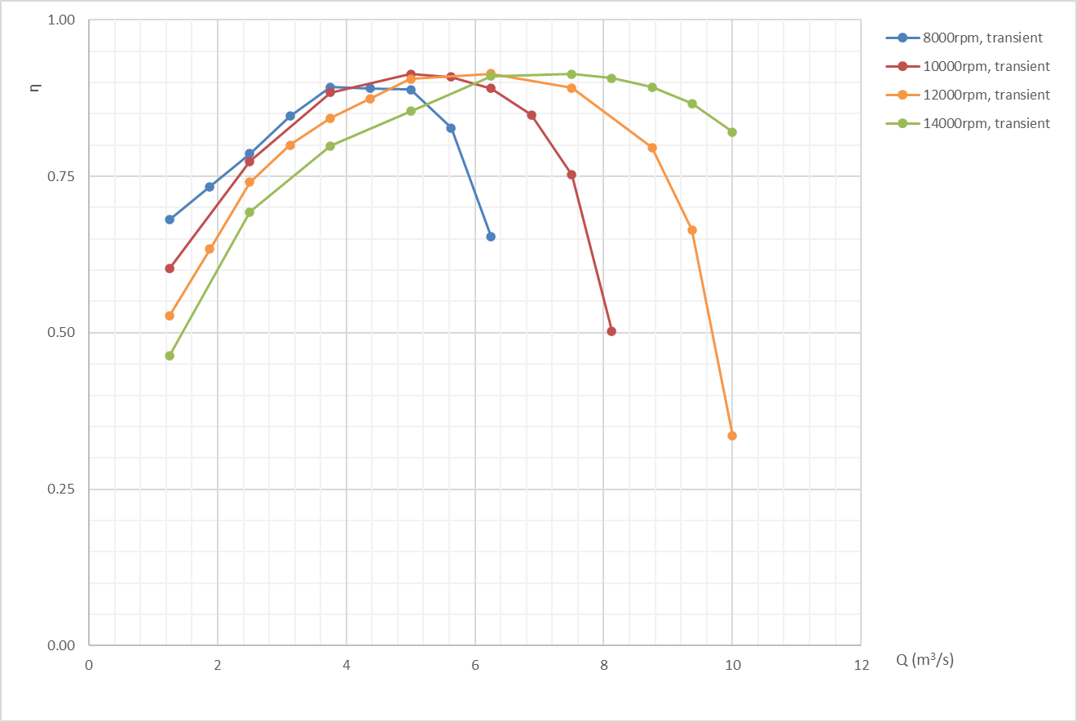
V. Open Results .csv File for Post-Processing
Wait for the program to finish
Within File Explorer, open the resultant .csv files
The averaged results of performance characteristics for each design point are displayed

